Slide 1

Slide 1
KCFED COIN GAME
Demietrius Huff
Connor Overton
Peter Copus
Jason Young
Alex Anstine

Slide 2


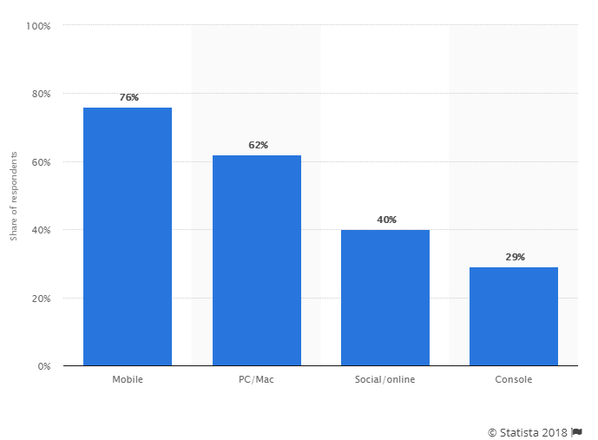

Slide 3
DATA DRIVEN
Customer preferred gaming platforms according to gaming companies worldwide as of August 2016
76%
62%
Mobile
PC/Mac
40%
29%
Social/Online
Console
This statistic presents information on customer preferred gaming platforms according to gaming companies worldwide, as of August 2016. According to the findings, only 29 percent of companies stated their customers preferred playing console games.
3

Slide 3
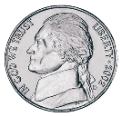

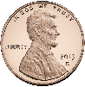


COIN NINJA
Coin ninja was designed for two reasons. To help kids learn addition and to keep them interested. Games that have quick achievable goals allow for faster reward that keeps the player intrigued longer and motivated; we also intend to include a leader board for the competitive ones. The game is simple, the player will be given an amount and will use the ninja to slice the coins as they fall to add up to the amount without exceeding it.

Slide 4

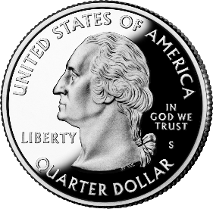


COIN DRAG
$1.75
Our coin drag has a similar design with a quick achievable goal. The main difference in this game is the variations in difficulty will not just test your hand eye coordination. With the higher difficulty levels the player will have to start using coins that they are not familiar with like the two cent coin or the half cent.
The game is straight forward, the player will be given a dollar amount and a variety of coins to chose from. The player will then click on a coin and drag it to the target. The objective of this game is to add up the exact amount without going over and with the least amount of coins possible. The game will be scored on the time it took and the amount of coins used.

Slide 5
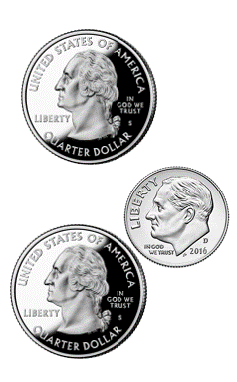

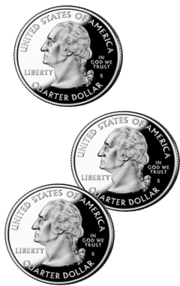
COIN MATCH
60
Coin match is the original game that we were given. We felt a need to keep it since it has already proven to be such a favorite. Our version, while introducing a leaderboard based on time taken, is otherwise identical to the version we were shown in person.
75

Slide 6
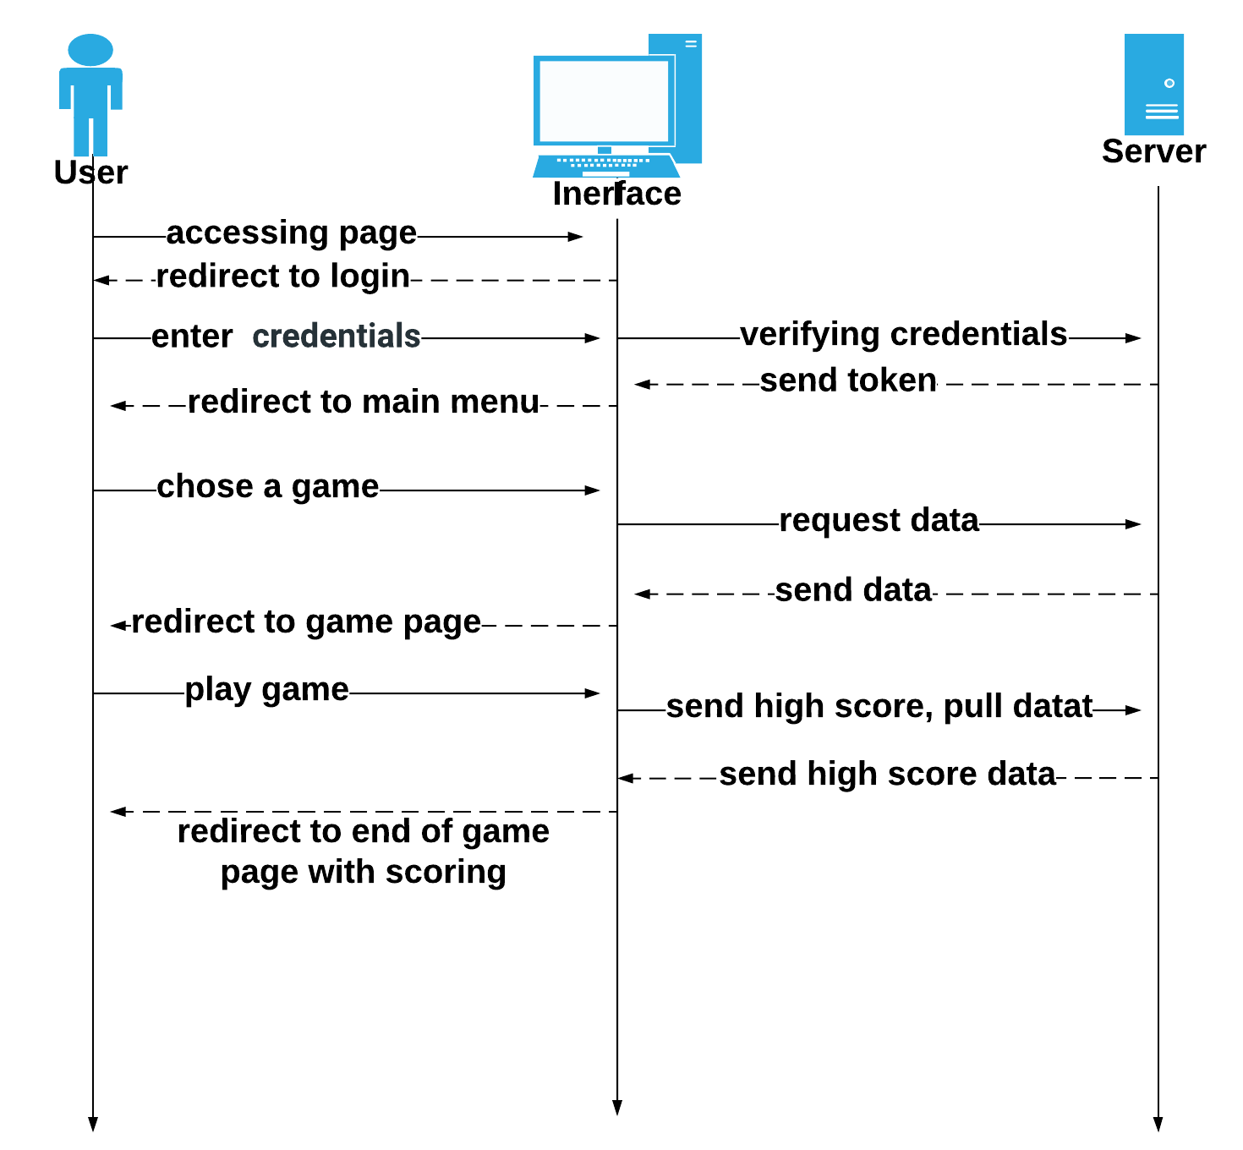

Slide 11

Slide 7

SUMMARY
We chose these games because we thought it could reach a wide range of people without compromising our primary goal of educating children of all age groups.
There are three games running a spectrum of excitement and educational potential to appeal to students and to help less-supervised children retain interest.

Slide 8
Slide 11
THANK YOU

Slide 9
Slide 11
Questions?

